Slide 1
DELTA R&D Project at SLAC
Heinz-Dieter Nuhn – LCLS Undulator Group Leader
Presented at
Monday, March 5, 2012

Slide 2
Project Motivation
SLAC has successfully commissioned the first x-ray FEL based on compact fixed gap planar undulators.
The compactness of the undulators allowed a unique and successful remote controlled alignment strategy.
Problem: Important desirable features are missing
Flexible polarization control
Support for large taper ranges required for TW FELs and high SXR output
Photon energy change at fixed electron energy
Standard Solution: Use variable gap / APPLE-II undulators
Variable gap undulators are large and heavy
LCLS alignment strategy is difficult to implement.
Proposed Solution: Compact variable phase DELTA undulator
Compact fixed-gap design very similar to LCLS undulators
Provides full K and polarization control.
R&D Issues
Standard magnetic measurement techniques won’t work when fully assembled
Tuning to FEL type requirements looks challenging
Installation of vacuum chamber in fully assembled undulator not yet solved

Slide 3
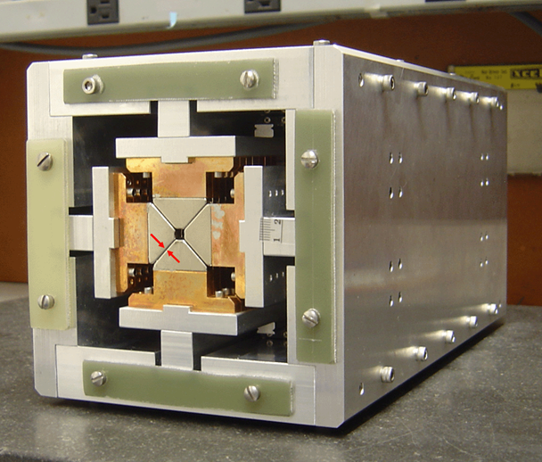
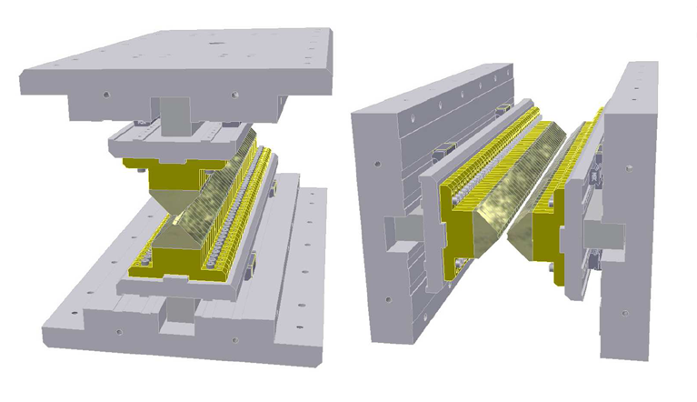
DELTA Undulator Model Developed and Tested at Cornell
Two adjustable phase undulators* assembled in one device**
30 cm long model built in Cornell
Greek Capital Delta Letter
Compact box-like frame (prototype has dimensions ~150mmx150mm)
Full polarization control
Sqrt(2) stronger field in planar mode and ~2X stronger in helical mode in compare with conventional Apple II type undulators.
Project was motivated by the Cornell ERL needs.
*R. Carr, Adjustable phase insertion devices as X-ray sources, Nucl. Instr. And Meth. A 306(1991) 391-396
**A. Temnykh, Delta undulator for Cornell energy recovery linac , Phys. Rev. ST Accel. Beams 11, 120702 (2008)

Slide 4
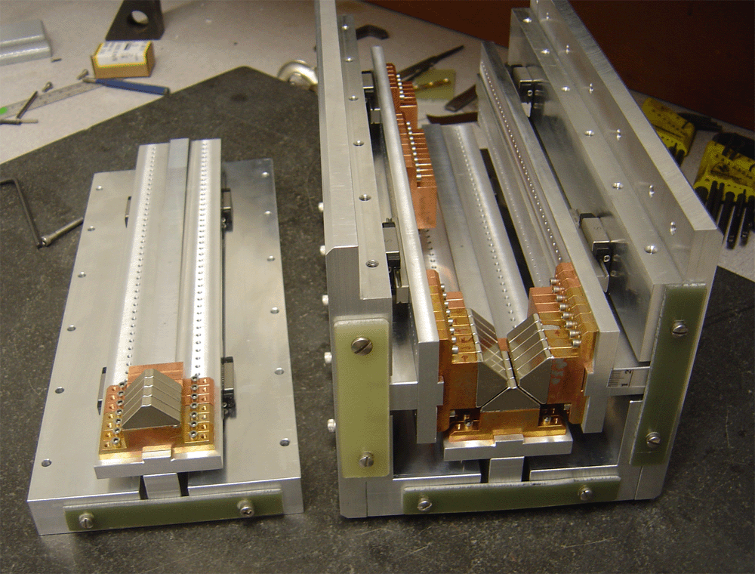
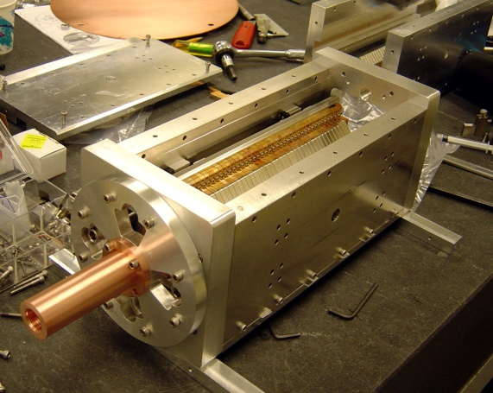
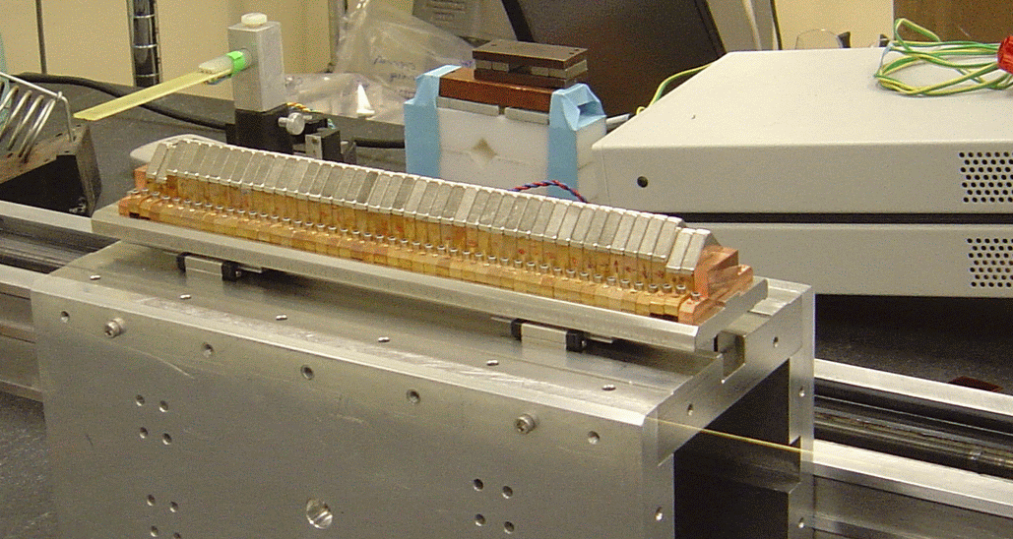
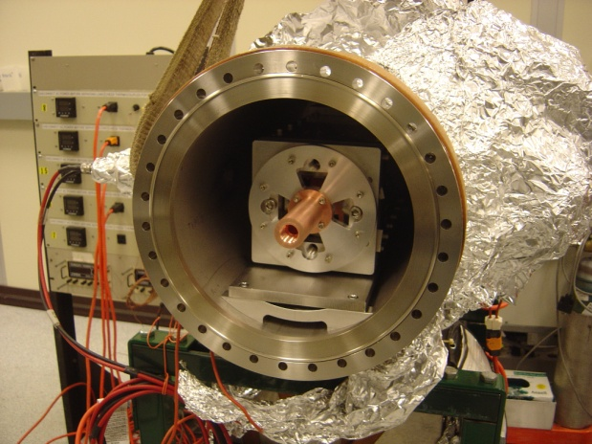
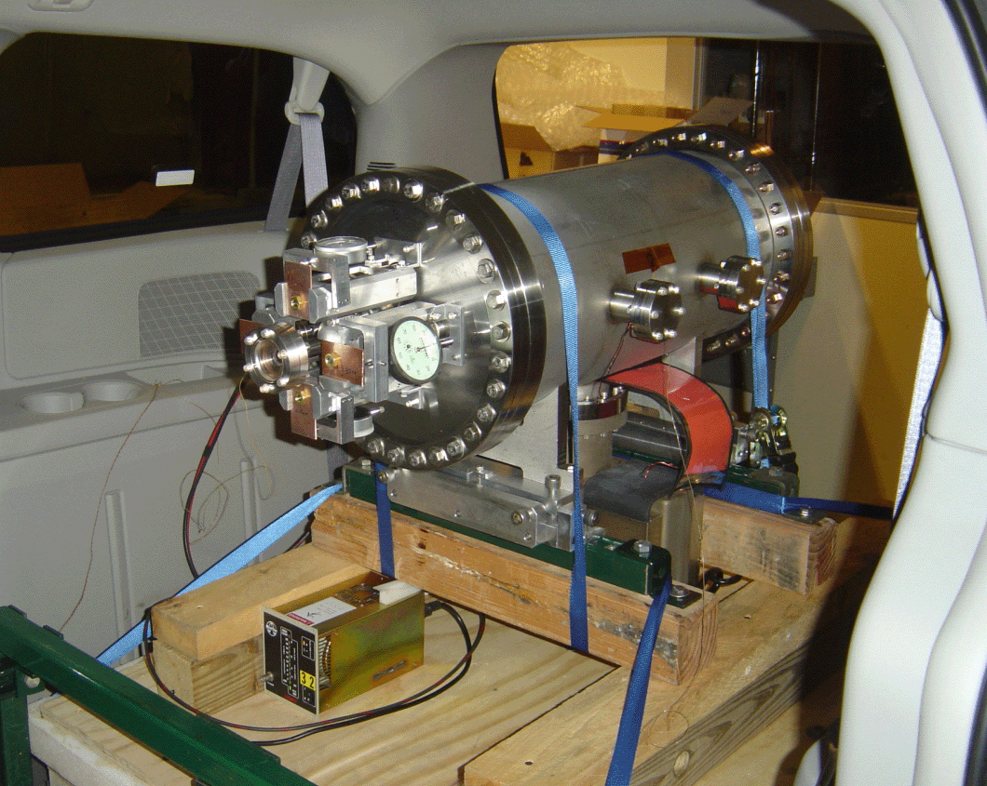
Cornell 30-cm Model: Construction Steps
Model parameters
PPM structure
NbFeB (40SH) Br =1.25T, H_{ci} > 20kOe
Undulator Period = 24mm
Device Length ~ 30cm
B_{max} (designed) in helical mode ~1.0T
B_{max} (designed) in planar ~ 1.4T
Assembly start
Test assembly and
dimensions check
Magnet field measurement and tuning
Model in vacuum vessel
Transport from Cornell to BNL

Slide 5
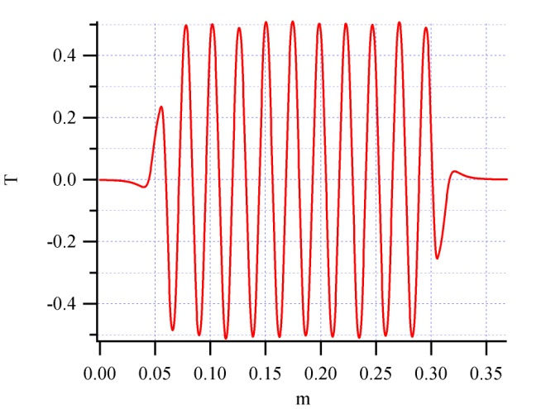
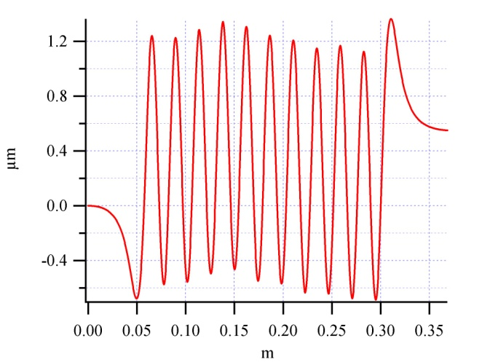
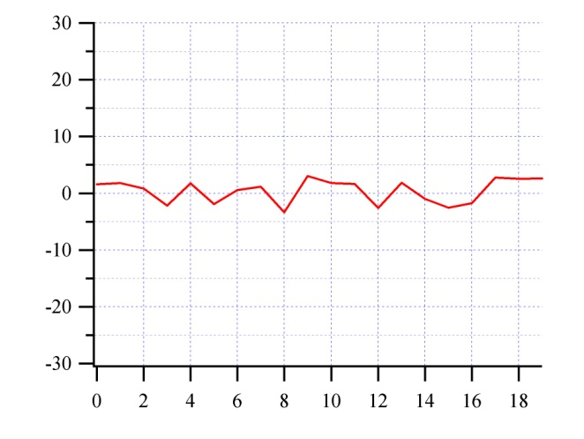
Cornell 30-cm Model:: Magnetic Field Tuning
“B_{y”} tuning with Hall probe
Conventional setup. For field analysis used B2E software from ESRF
(1)
(2)
Hall probe sensor (HGT-2101) mounted on sliding stage
Sliding stage
Optical phase errors,
RMS ~2.0deg
B_{y} along magnet
Trajectory

Slide 6
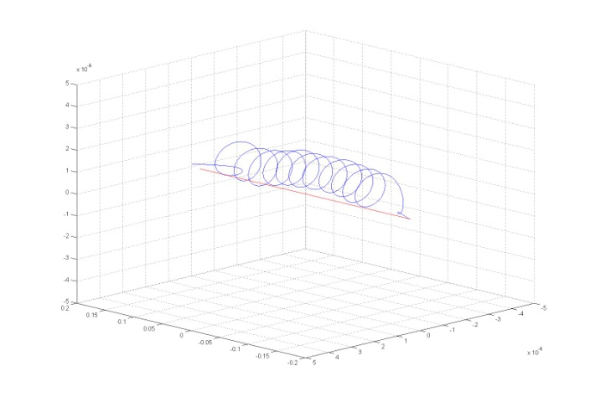
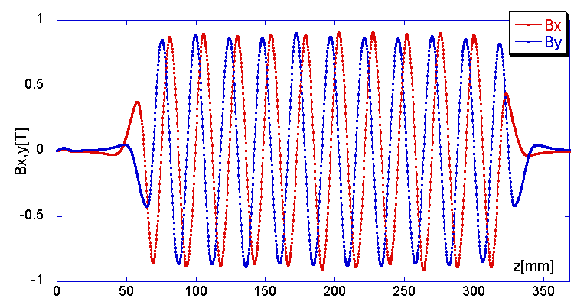
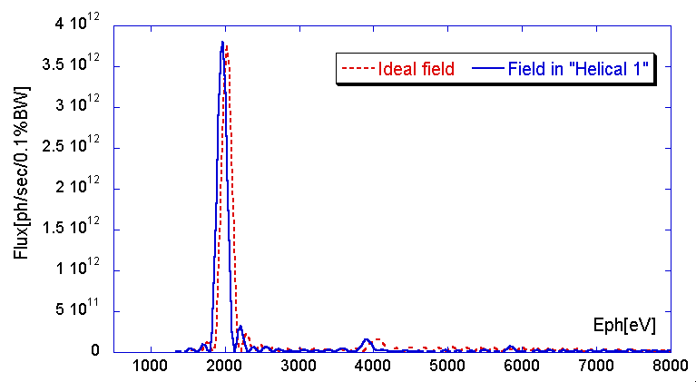
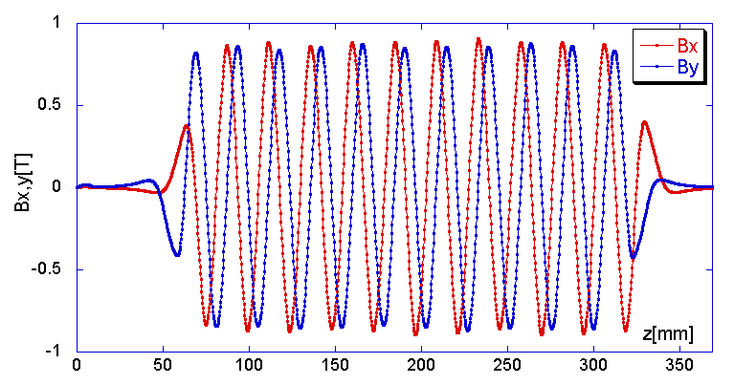
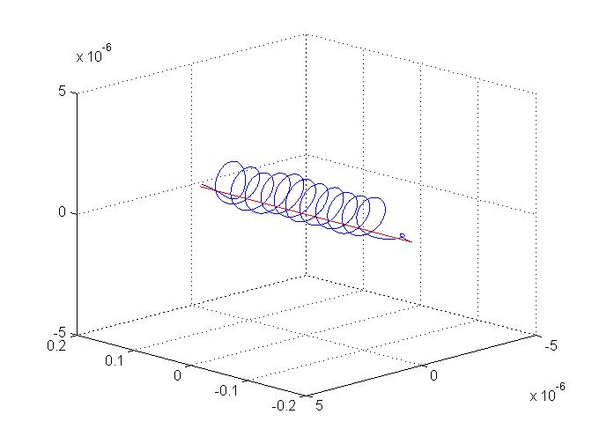
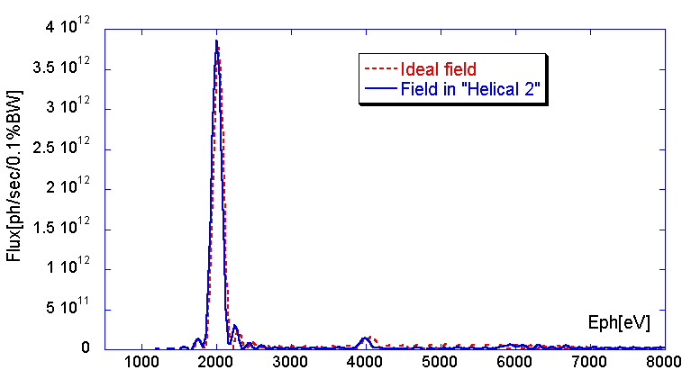
Cornell 30-cm Model: Field Properties in Helical Mode
Measured field components
Trajectory
X-ray Spectra
Helical mode, left circular polarization (phase between vertical and horizontal pairs 90⁰)
Helical mode, right circular polarization (phase between vertical and horizontal pairs -90⁰)

Slide 7
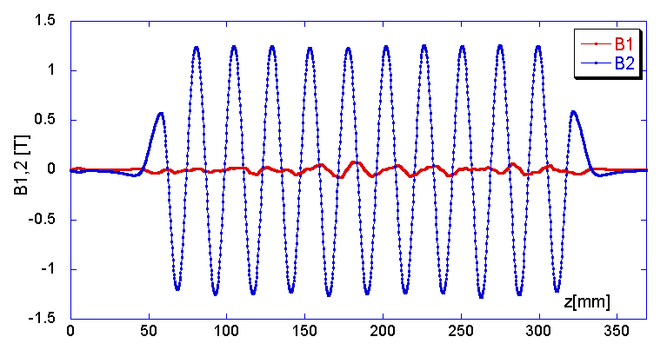
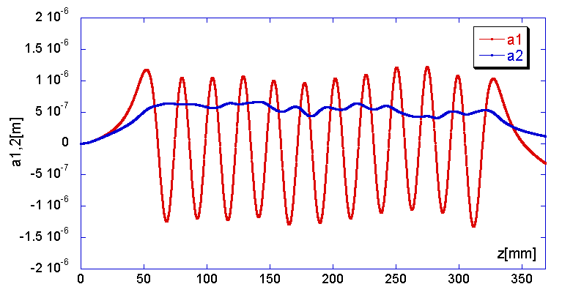
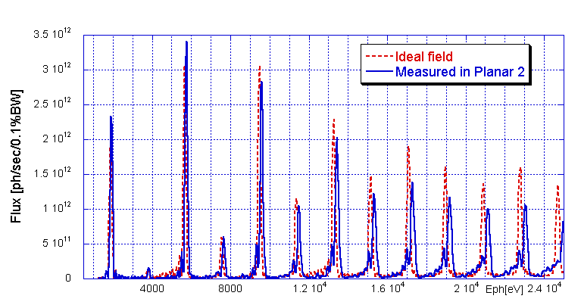
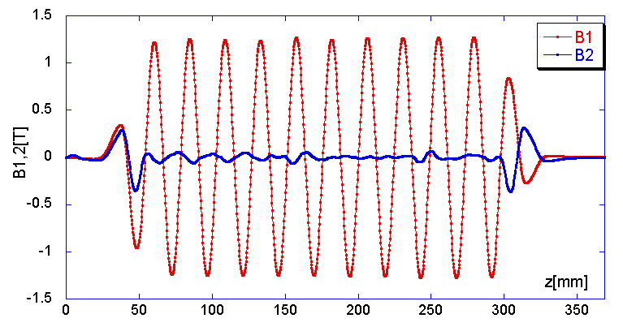
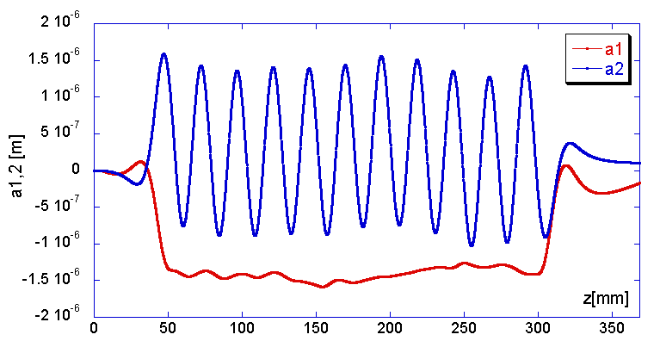
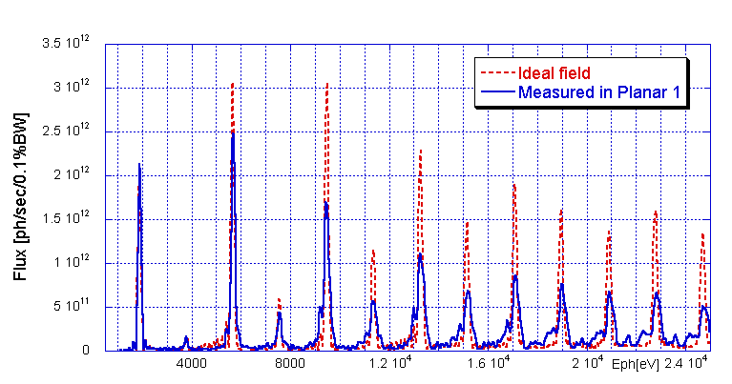
Cornell 30-cm Model: Field Properties in Planar Mode
Measured field components
Trajectory
X-ray Spectra
Planar mode, - 45deg linear polarization (phase between vertical and horizontal pairs 180deg)
Planar mode, +45deg linear polarization (vertical and horizontal pairs in phase)
Note: B1 and B2 two orthogonal field component tilted relative horizontal and vertical axis by 45deg.

Slide 8
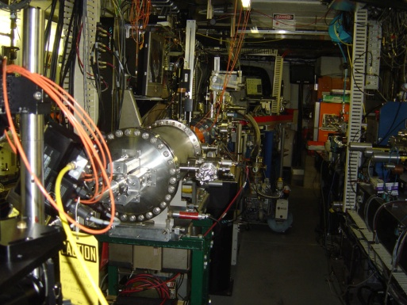
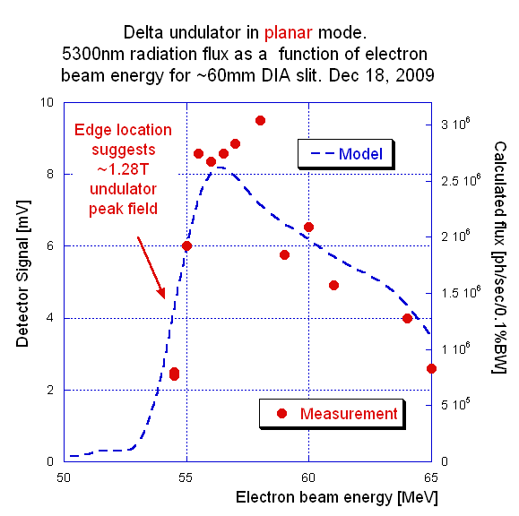
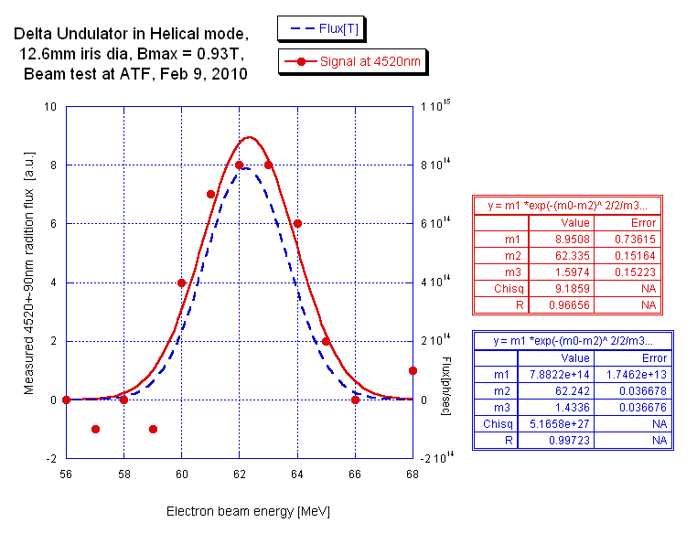
Cornell 30-cm Model: Beam Test at the ATF/BNL
Model in vacuum vessel
Transport from Cornell to BNL
Delta undulator installed in BL2 ATF.
First harmonics in planar and helical mode
5300 nm wavelength radiation as function of the electron beam energy.
Signal confirmed 1.28 T peak field in undulator
4520 nm (bottom) and 3600 nm (right) wavelength radiations versus beam energy. Both data confirmed 0.93 T field amplitude.
A. Temnykh, et al., Delta undulator model: Magnetic field and beam test results. Volume 649, Issue 1, 1 September 2011, Pages 42-45

Slide 9
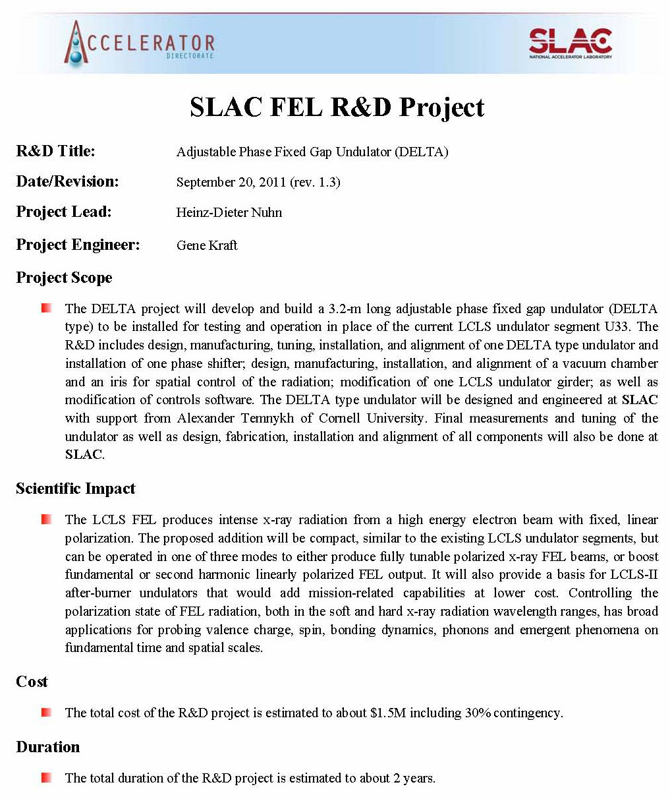
DELTA Project Synopsis
Conceptual Design is completed
CDR: 11/18/2012
Positive Report: 12/12/2012
Funding Approval: 12/13/2012
Gene Kraft the Project Engineer
Sasha Temnykh will provide technical support
Rough cost estimate: $1.6M
Rough schedule estimate: 2 years
$1.6M

Slide 10
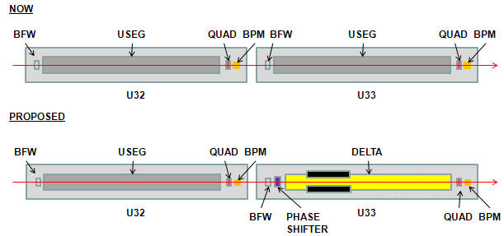
Proposed Change to LCLS Undulator Line
Delta Undulator will occupy space freed by removed LCLS segment.
(Later Addition)
Phase shifter will be added, later.

Slide 11
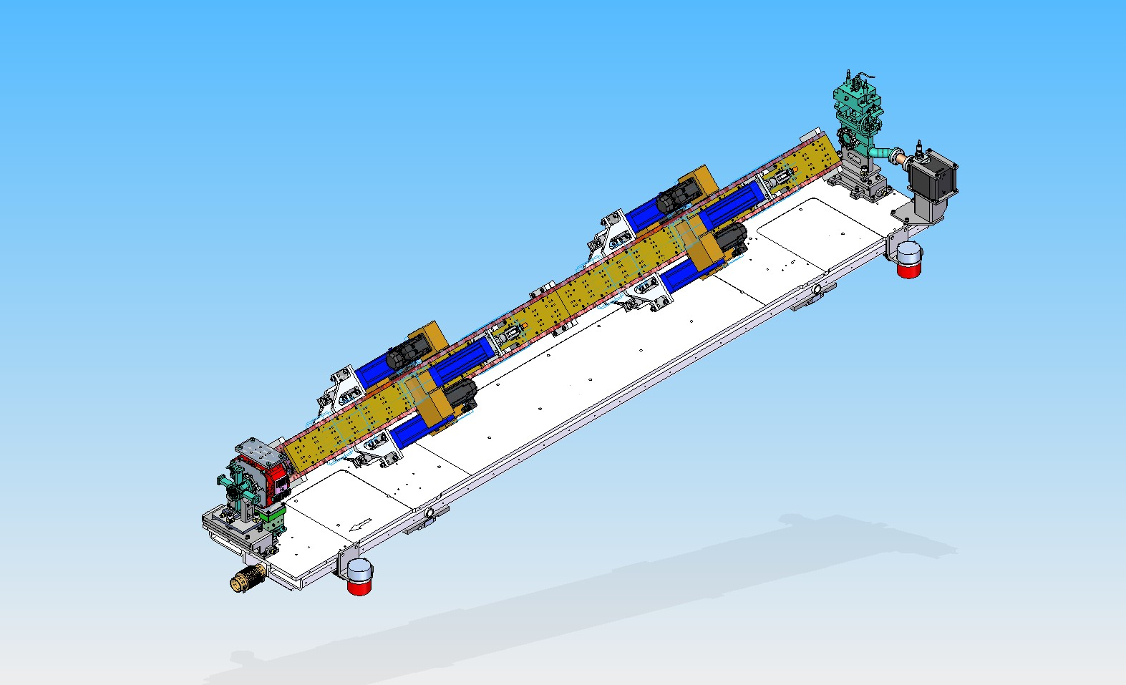
Isometric View – Installed on Girder
Beam Direction

Slide 12
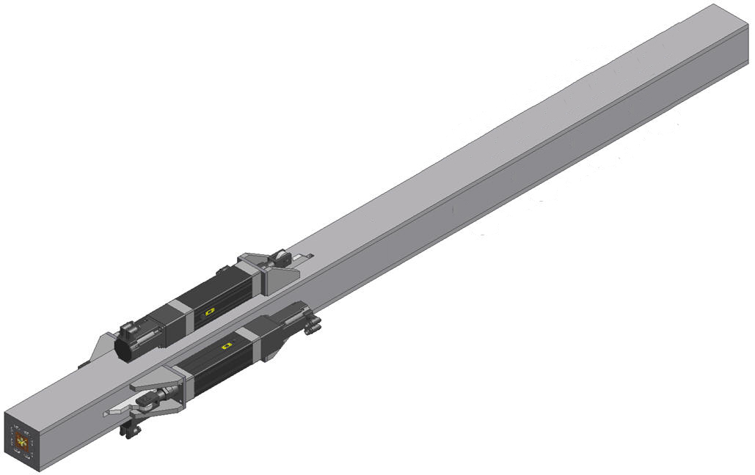
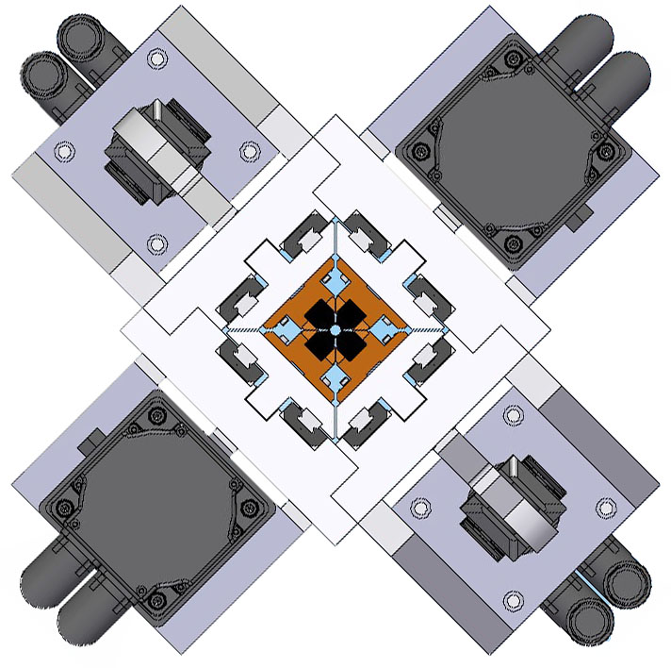
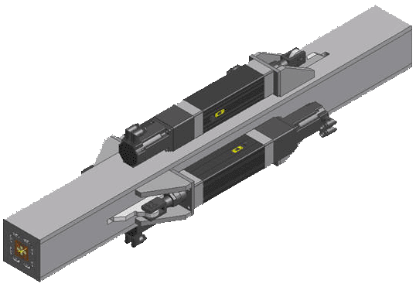
Project Scope
Build out-of-vacuum version of the Cornell DELTA undulator model at 3.2-m length.
Develop techniques for tuning and measurement of undulators that don’t permit side access.
Develop new vacuum chamber
Replace present undulator U33 and horizontal slide support with DELTA undulator
Incorporate into LCLS EPICS control system
(Start with 1.6-m long prototype)
Vacuum Chamber
PROTOTYPE

Slide 13
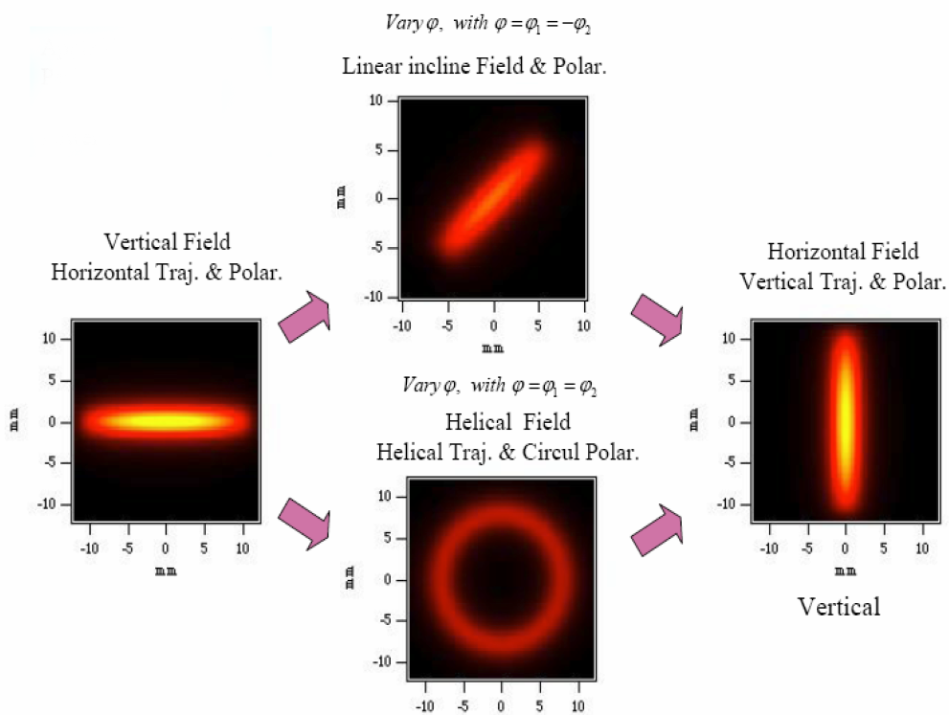
Variable Phase Undulator for Polarization Control
4 Movable PM Quadrants
Four independent quadrants of permanent magnets move longitudinally at fixed gap.
By sliding the arrays it is possible to control the K from full to zero
and to control the polarization of the radiation emitted

Slide 14
Scientific Motivation
Short Term Benefits:
Provide x-ray radiation with controllable degree of polarization (left or right circular, vertical or horizontally linear)
Provide increased tapering range in horizontally planar mode to increase LCLS FEL radiation output, particularly in HXRSS self seeding mode.
Long Term Benefits:
Helical undulator to build shorter LCLS-II TW extension
Build future x-ray FELs with full polarization control, full tunability under LCLS type alignment control.

Slide 15
General 1.5 m Permanent Magnet Assembly Detail
Moveable Strongback 6061-T6 Aluminum
Z
Rectangular Frame 6061-T6 Aluminum
TSK Linear Slide (13 pairs/quadrant)
Linear Actuator (1/quadrant)
PM w/Holder (200 pairs/quadrant)
Notes:
The key components can be seen more clearly here.

Slide 16
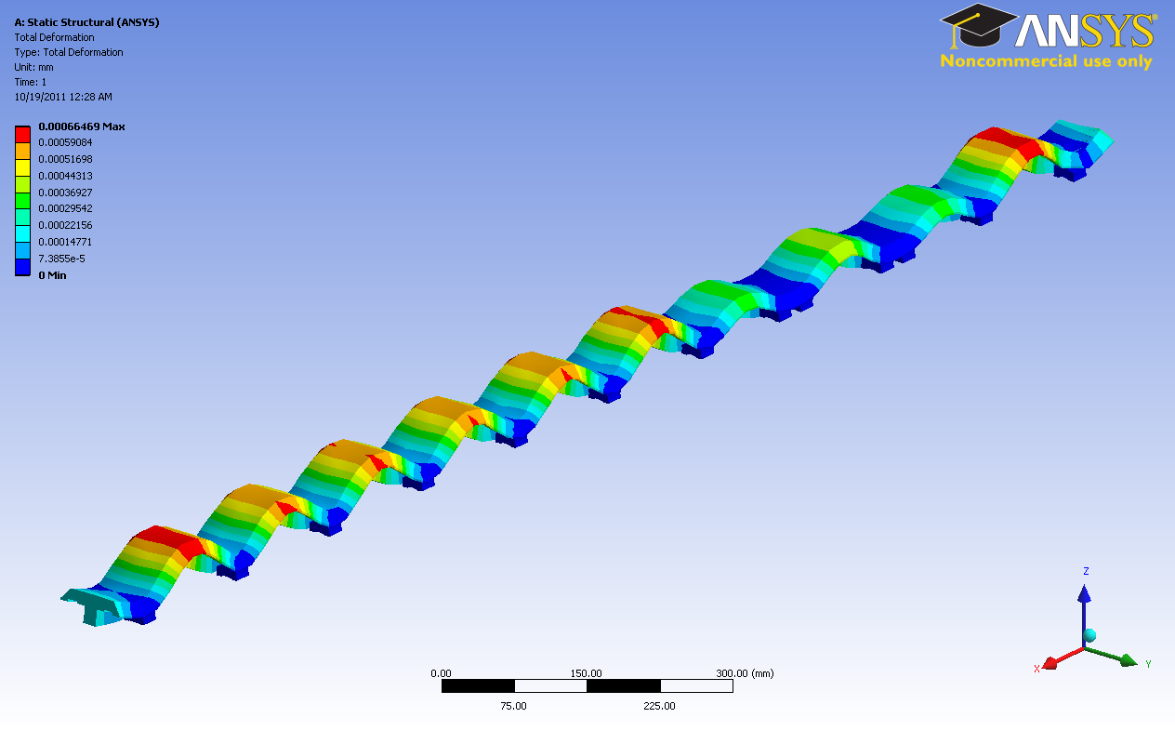
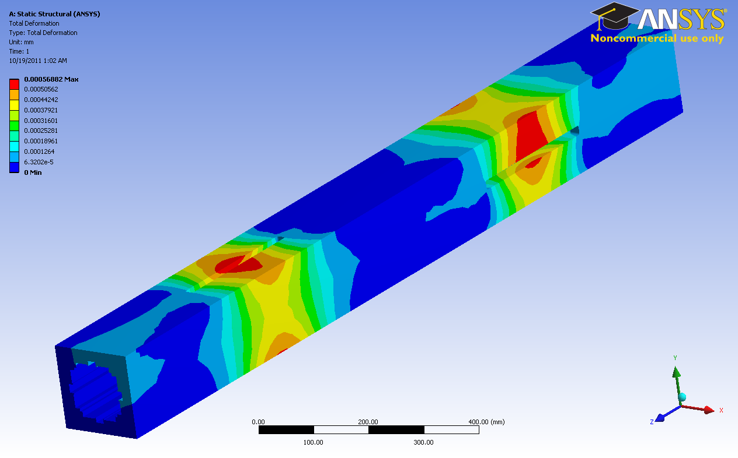
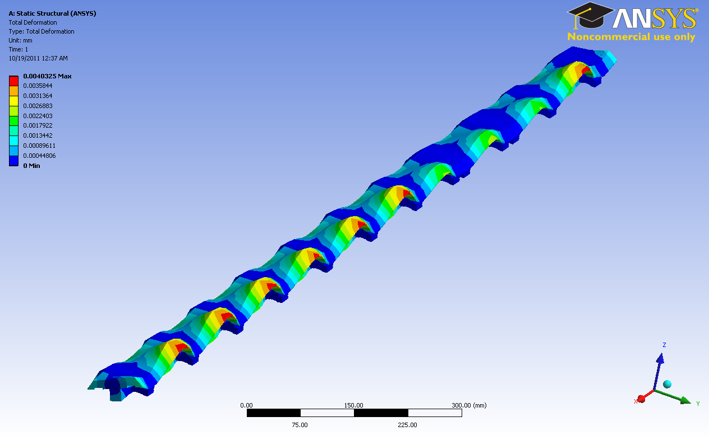
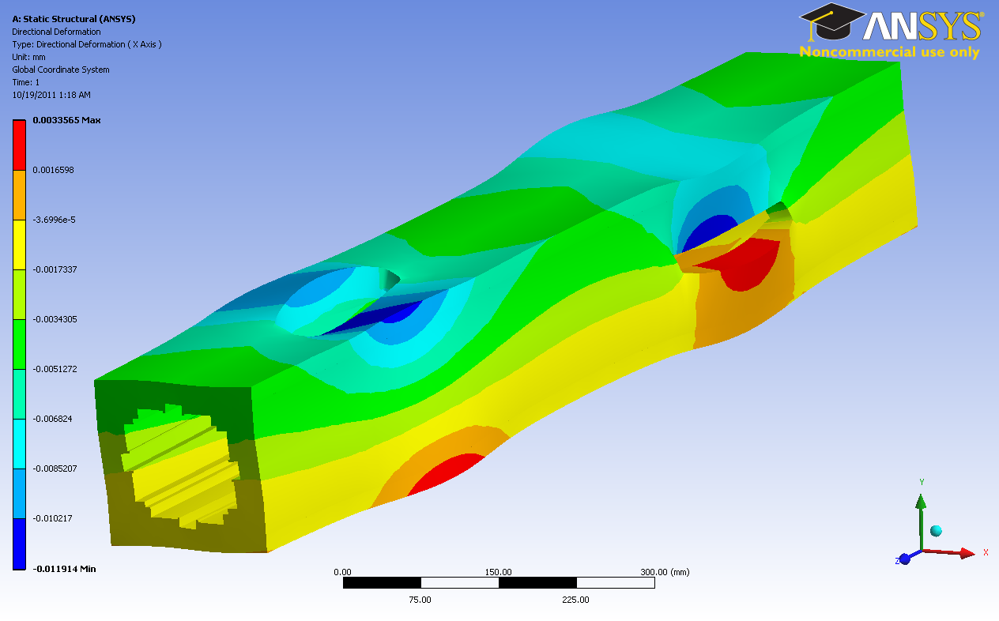
Deformation of ONE Base and Frame under Magnetic Forces
Base, Helical mode
Frame, Helical mode
Maximum deformation ~0.7μm
Maximum deformation ~0.6μm
Base, Planar mode
Frame, Planar mode
Maximum deformation ~4.8μm
Maximum deformation ~6μm
In “zero” field modes deformations are not critical for the undulator performance
Notes:
ANSYS Stress Analysis indicates maximum deflections are relatively small based on the worst case loading conditions of the previous slide for both helical and planar modes. However, the effects on overall performance are not fully understood. In “zero” field modes deformations should not be critical for the undulator performance.

Slide 17
Vacuum Chamber Assembly
Previously attached Vacuum Flange
6.35 OD Ceramic Guide Rod
Vacuum Chamber Tube
Undulator PM Assembly
Chamber insertion would require guide rod to push/pull the tubing through the 3.2 m Undulator Assembly
Notes:
This is one possible solution being investigated. A 6.35 mm ceramic tube (as used for an MMF measurement fixture) could be used as a guide rod to help negotiate the vacuum chamber tube through the permanent magnets. A special adaptor would need to be applied to the mating end of this guide rod. The vacuum chamber tube could be either pushed with light pressure or pulled with the guide rod securely attached to the open end of the tube to prevent damage to the end of the tube or impacts of the tube on the PMs.

Slide 18
Vacuum Chamber Assembly
Second Flange Attached
Possibly attached by induction braze
Vacuum Chamber Tube w/ Previously Attached Flange
Undulator PM Assembly
Fixture for proper flange orientation
This step to be done in MFD Vacuum Cleanroom.

Slide 19
Vacuum Chamber Design Challenges
Cornell prototype undulator was an in-vacuum device. Our internal vacuum chamber made from tubing is a new approach, first time attempted
Vacuum Chamber must be installed after Magnetic Measurements Group assembles and verifies the 4 quadrants as one unit
Chamber must pass through the magnet pole tips, therefore a vacuum flange cannot be installed until after the chamber is inserted
Vacuum chamber must have minimal “sag” to avoid/minimize permanent magnet pole tips rubbing on the OD of the vacuum chamber tubing and to reduce transverse wakefields.
Chamber is effectively a very long thin wall tube susceptible to bending, difficult to clean and transport (weight is under 1 pound)
Attachment of end flange on pass-through end of chamber may cause thermally induced distortion compromising tube straightness

Slide 20
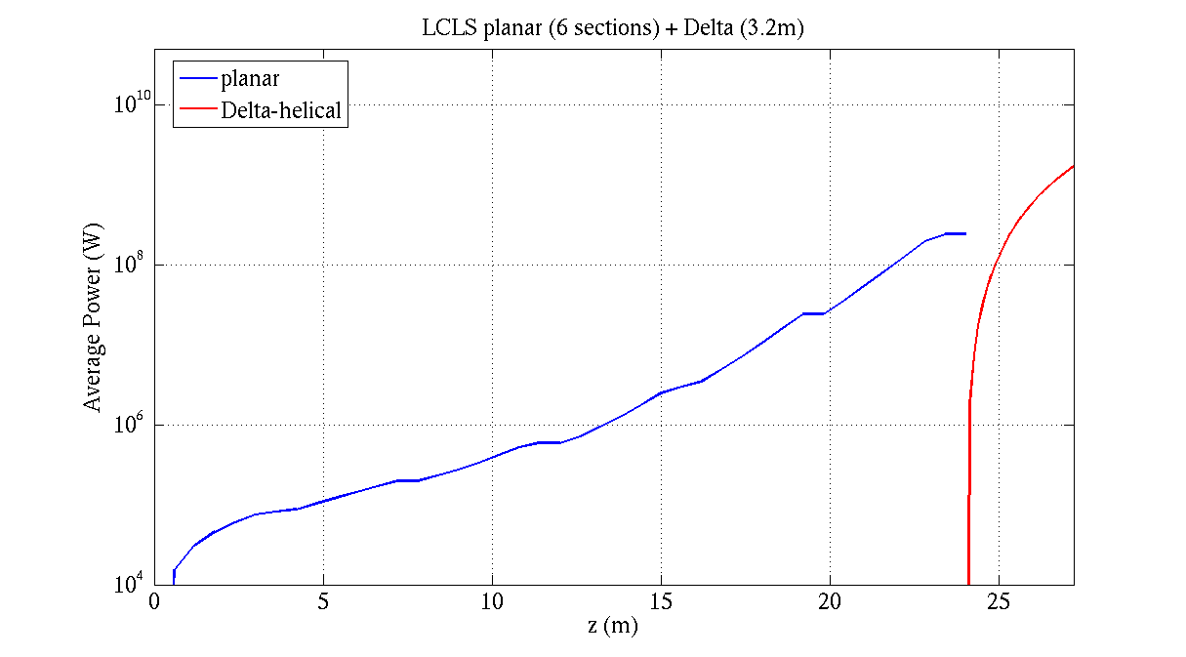
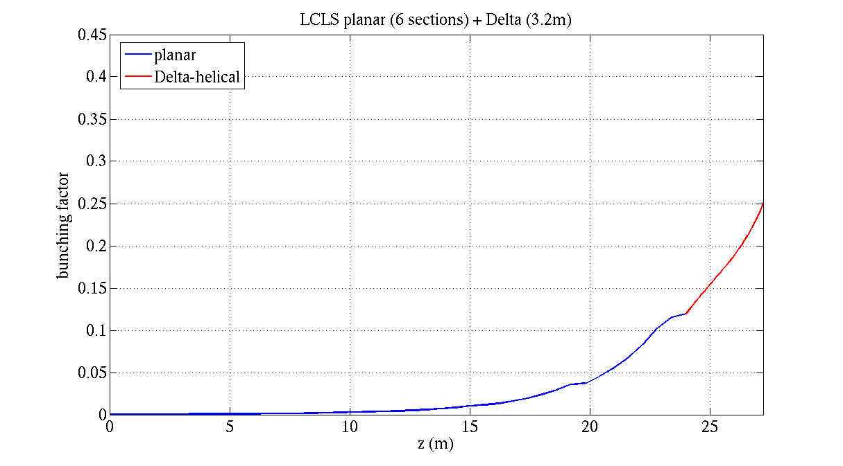
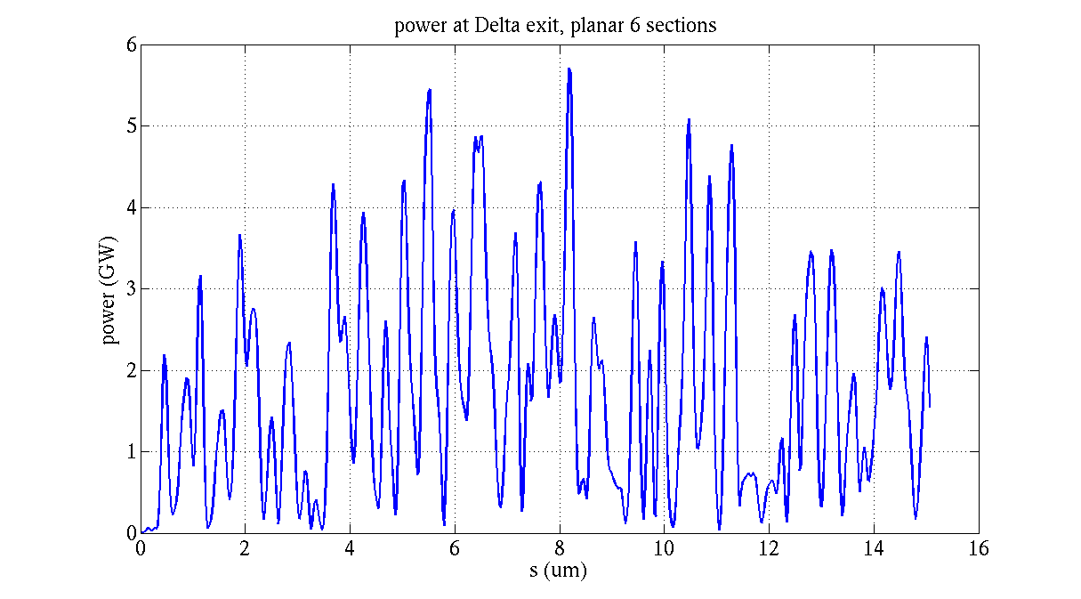
GENESIS 1.3: 830eV, 2kA, 6 planar sections + Delta 3.2 m
LCLS planar undulators
Delta, helical
Circular polarization : 87%. planar power 0.24 GW,
circular power 1.7 GW
Yuantao Ding

Slide 21
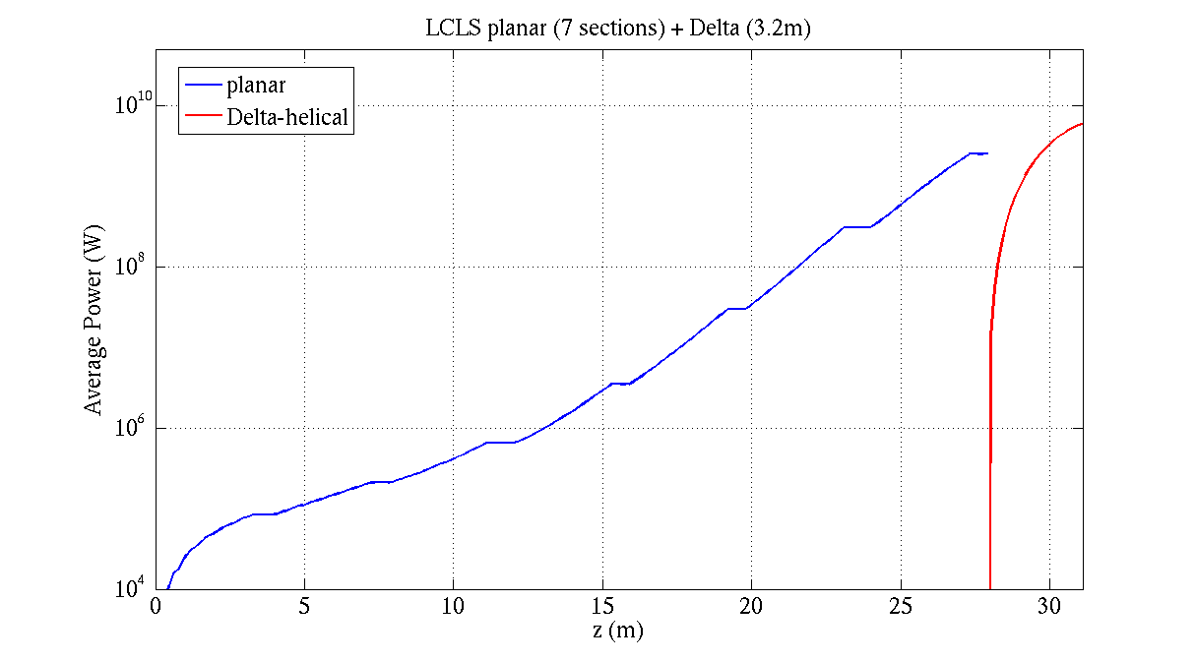
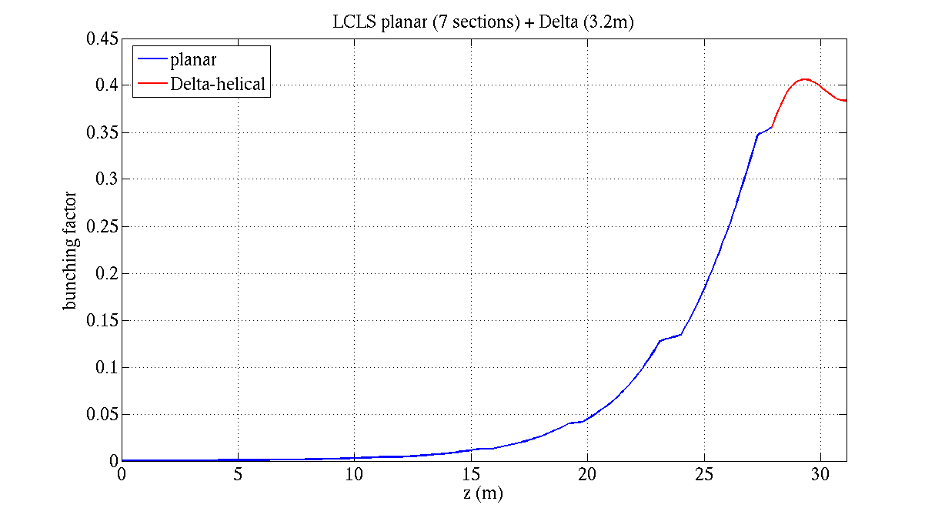
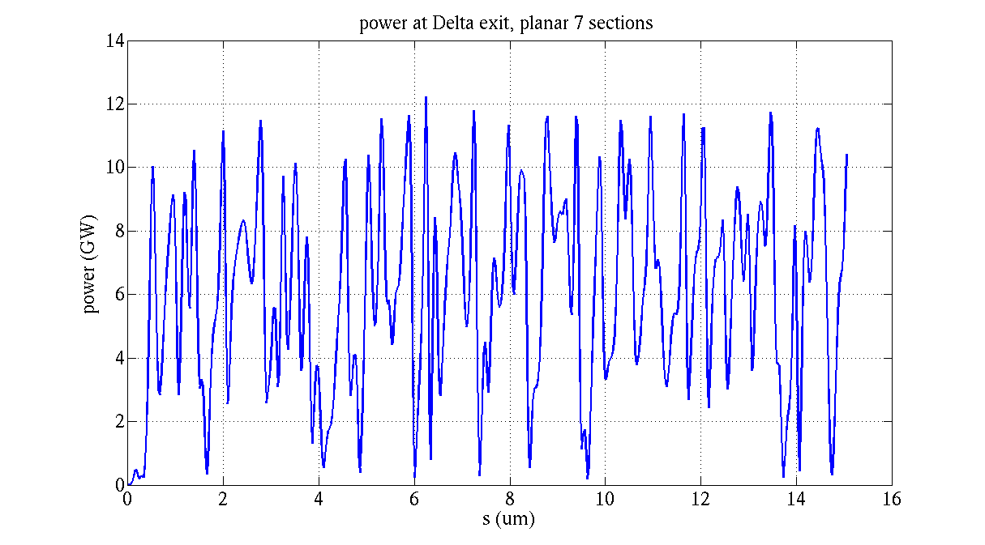
GENESIS 1.3: 830eV, 2kA, 7 planar sections + Delta 3.2 m
LCLS planar undulators
Delta, helical
Circular polarization : 70%. planar power 2.5 GW,
circular power 6.0 GW
Saturation regime in Delta.
Yuantao Ding

Slide 22
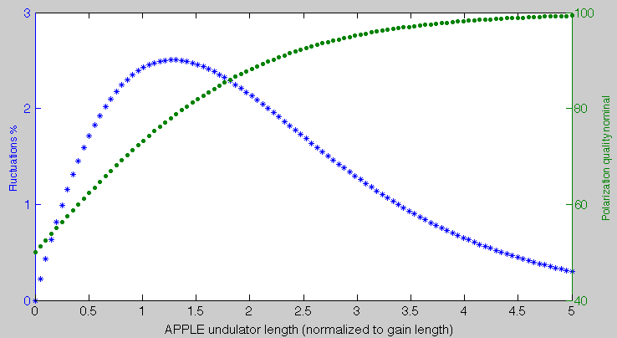
Fluctuation of the polarization
The ratio between the circular power and the planar power determines the degree of polarization.
Current jitter affects the FEL gain, hence affects the planar and circular FEL power.
need further work on the fluctuation issues.
Gain length is about 1.6 – 2m in the soft x-ray wavelength.
E. Allaria

Slide 23
Polarization Simulations Discussions
The 3.2-m-long DELTA undulator should provide about ~70% circular polarization with a few GW FEL;
Higher power levels can be obtained with lower degree of circular polarization;
Enrico Allaria proposed to detune one of the undulator K to optimize the output. We can also consider to use laser heater, or peak current to control FEL power and degree of polarization.
Fluctuation estimates need more. Expected are levels of ~5%;
Other tricks may be considered, e.g., transverse truncation of the linear polarized component. (As suggested by Geloni et al.)
Yuantao Ding

Slide 24
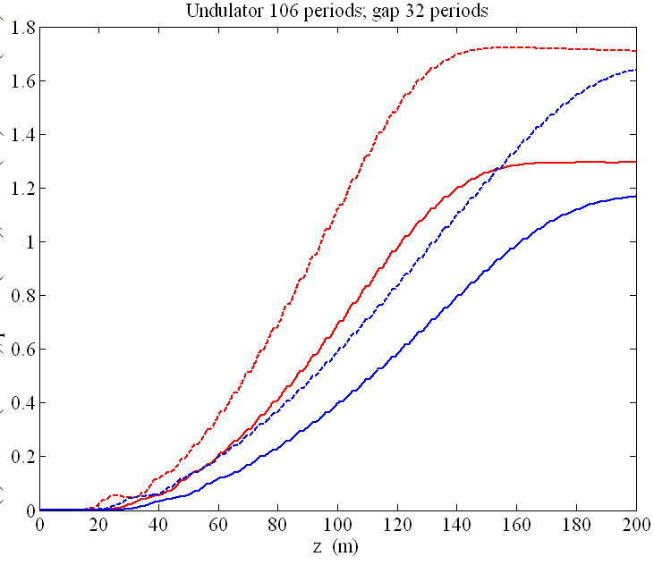
Helical Undulator Use to Enhance TW FEL
Shorten the system or increase power by 50%
Extend to 13 keV (LCLS-II highest photon energy)
Reach 1 TW within 100 m undulator at 8 keV (after seeding)
Helical: (dashed)
Planar: (solid)
8 keV
Power (TW)
13 keV
DELTA R&D Project at SLAC
Page 24

Slide 25
Summary
The DELTA R&D project includes developing a compact polarization control undulator for LCLS based on the DELTA undulator developed by A. Temnykh at Cornell.
There are two goals
Primary Goal : Develop undulator that produces radiation with controllable degree polarization (circular, linear vertical and horizontal).
Secondary Goal : Test if DELTA undulator tuning and magnetic measurements can be developed to meet FEL type tolerances. To support future FELS and LCLS-II TW extensions.

Slide 26
End of Presentation

